Slide 1
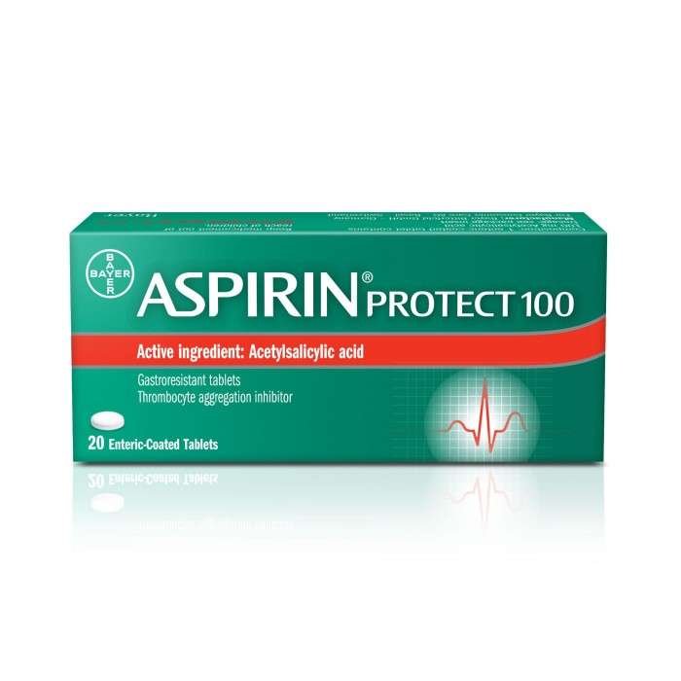
Aspirin
Aspirin Protection 100 mg tablets 60 pills
SAR 19.05. Q

Slide 2
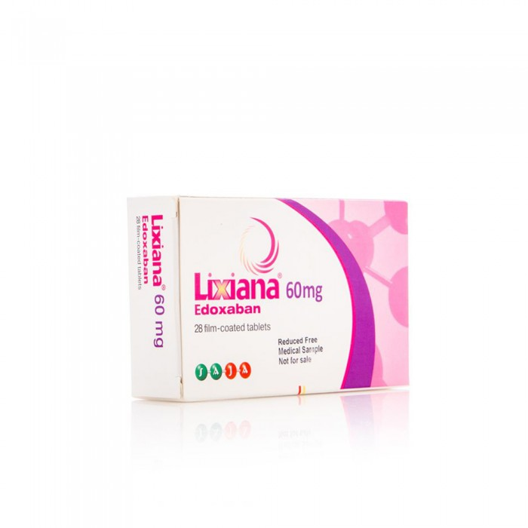
Lexiana
Lexiana 60 mg tablets 28 pills
240.00 SAR Q

Slide 3
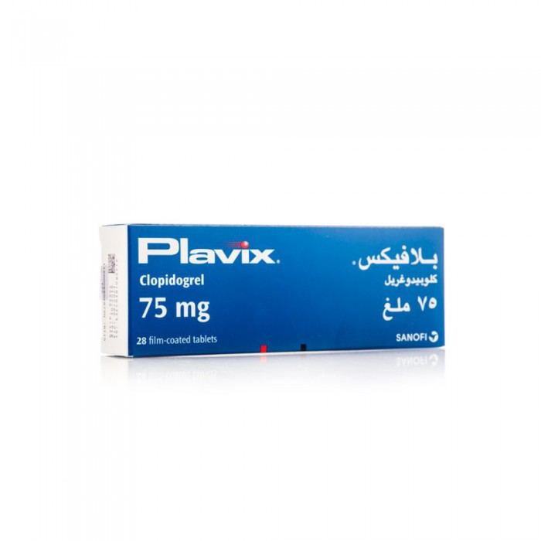
Blavex
Plavix 75g tablets 28 pills
SAR 248.15 Q

Slide 4
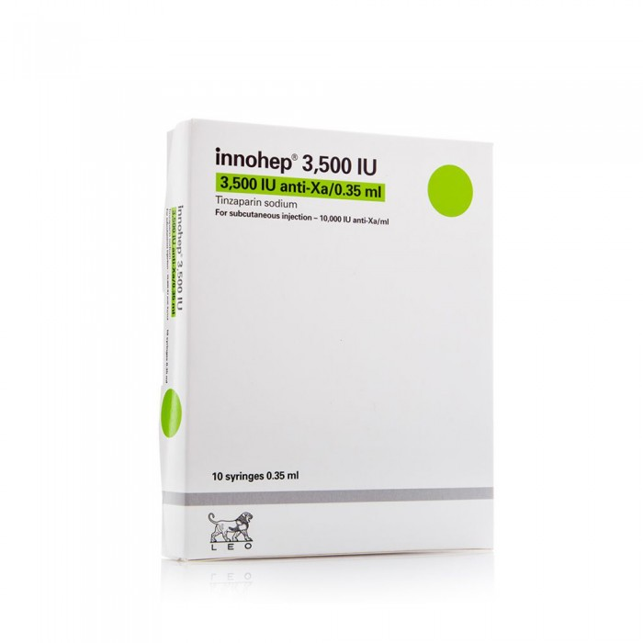
Inohip
Enohip 3500 Injection Unit 0.35 ml 10 Needles
148.90 SAR. Q

